Slide 1
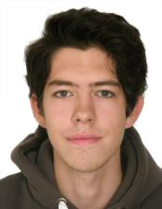
Who am I?
Bachelor’s degree in Applied Mathematics and Informatics (HSE)
Master’s degree in Data Science (HSE)
Conducted course on Deep Learning in HSE university. Materials of course: https://www.coursera.org/learn/intro-to-deep-learning
In Deloitte Moscow: April, 2018 – July, 2019
Work in Deloitte M.E since July, 2019
Fond of: Mathematics (Analysis, Linear Algebra, Probability theory, Discrete Mathematics), Alogithms and Data
Structures, Data Science

Slide 2
Training session #1: What is Machine Learning?

Slide 3
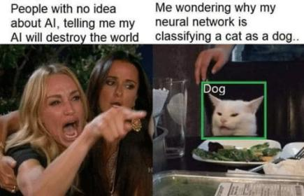
Machine Learning IS NOT fishy fairytales about artificial intelligence, data-science magic, and jobs of the future.

Slide 4
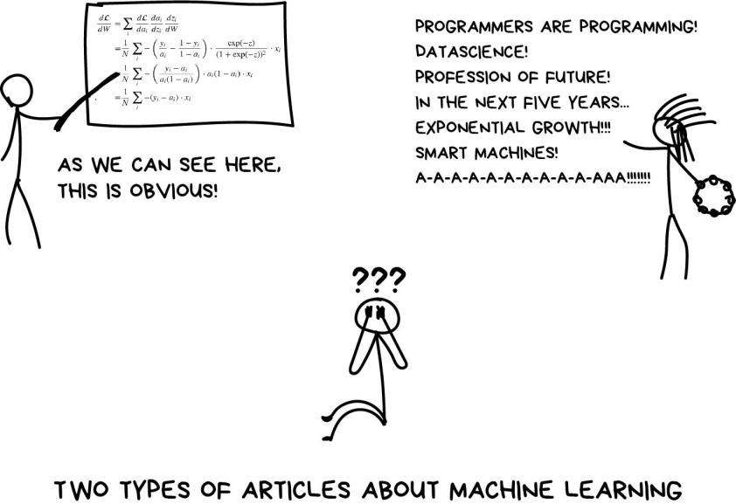

Slide 5
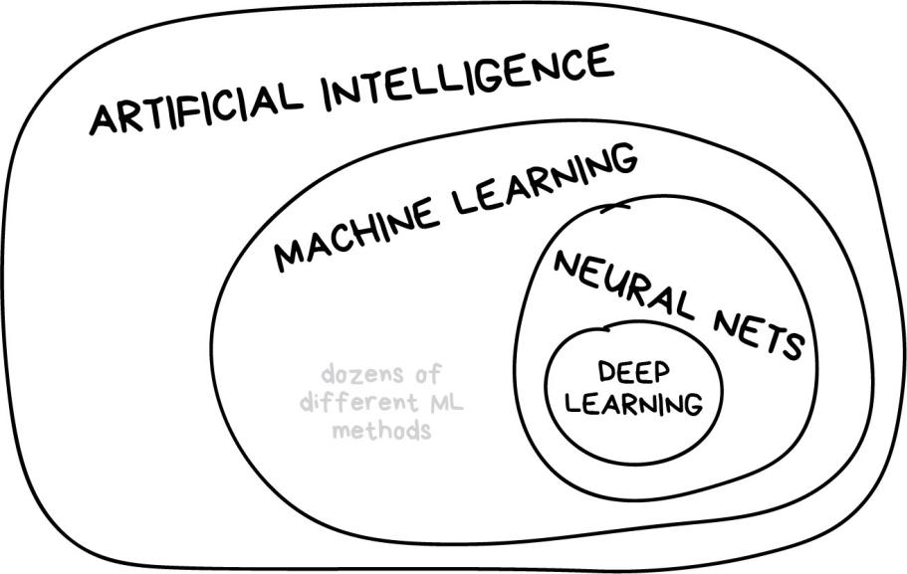
Training session #1: What is Machine Learning?

Slide 6
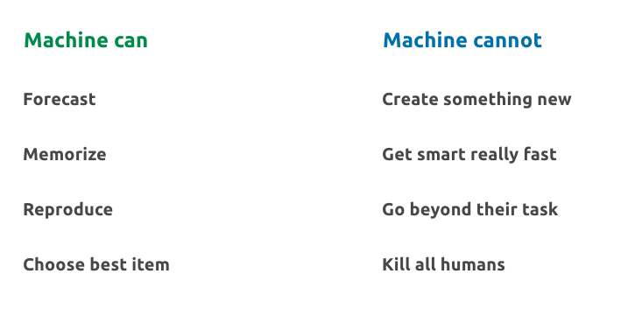
Training session #1: What is Machine Learning?

Slide 7
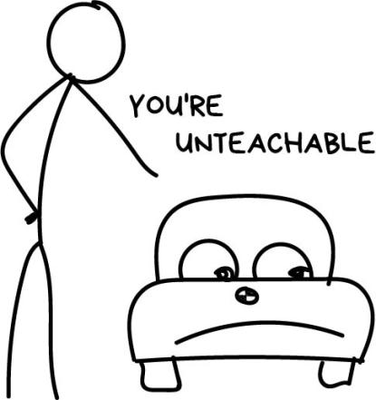
Why do we want machines to learn?

Slide 8
Simple Example:
Billy wants to buy a car. He went over dozens of ads and learned that:
New cars are around $20,000
Used year-old ones are $19,000
2-year old are $18,000 and so on
Billy, our brilliant analytic, starts seeing a pattern: so, the car price depends on its age and drops $1,000 every year. But won't get lower than $10,000.
=> Regression!

Slide 9
Problem:
Cars have different manufacturing dates, dozens of options, technical condition, seasonal demand spikes, and god only knows how many more hidden factors.
An average Billy can't keep all that data in his head while calculating the price. Me too.
People are lazy => force machine to find patterns => birth of machine learning

Slide 10
Without all the AI-s**t, the only goal of machine learning is to predict results based on incoming data
Three components of machine learning:
1. Data
2. Features
3. Algorithms

Slide 11
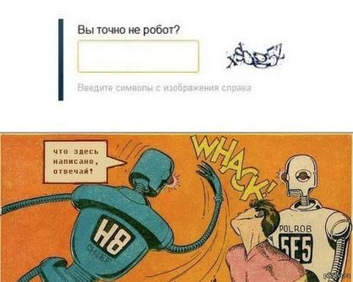
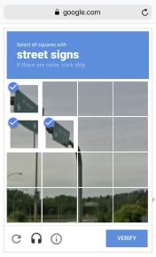
Data
- Want to predict something? Find data
Manual and automatic collection. Manual is more accurate, Automatic is cheaper
Cheap services https://www.mturk.com for manual data labeling
Somebody is very cunning and use their own customer to label data (ReCaptcha as well):
Are you robot?
Write symbols from the picture
Say what is written here?

Slide 12
Features (aka parameters or variables):
Examples:
car mileage, user's gender, stock price, word frequency in the text
When data stored in tables it's simple — features are column names

Slide 13
Algorithms
The method you choose affects the precision, performance, and size of the final model. For simple models - CPU, for hard models - GPU
Most important nuance:
If there is no dependency in the data even the best algorithm won't help (garbage in – garbage out)

Slide 14

The map of the machine learning world

Slide 15
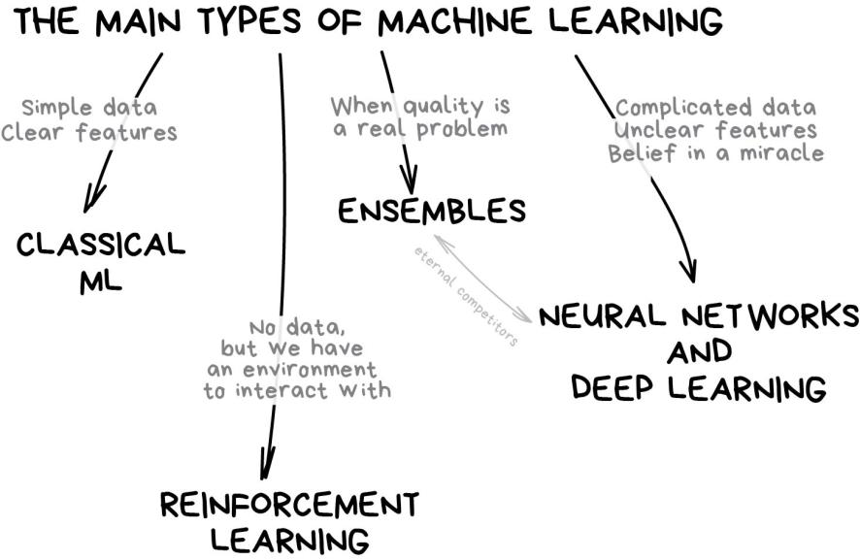
Training session #1: What is Machine Learning?

Slide 16
Classical Machine Learning
Came from pure statistics in the '50s
- When you see a list of articles to "read next"
- Prediction of traffic jams
- People You May Know in Facebook
- Email Spam
- Bank blocks your card at random gas station in the middle of nowhere

Slide 17
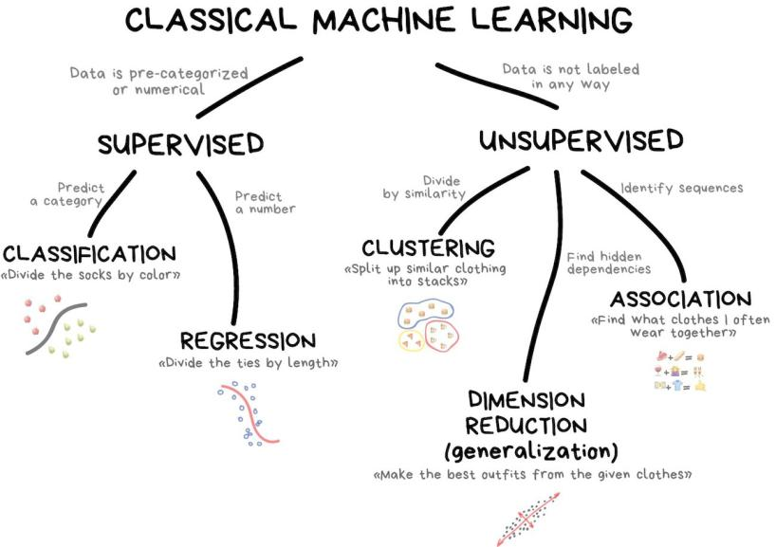

Slide 18
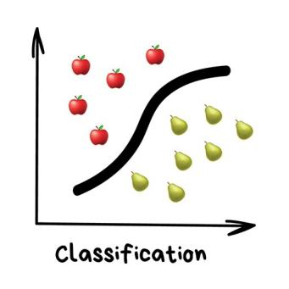
Classification: Splits objects based at one of the attributes known beforehand
Today used for: – Spam filtering – Language detection – A search of similar documents – Recognition of handwritten characters and numbers – Fraud detection

Slide 19
Popular algorithms: Naive Bayes, Decision Tree, Logistic Regression, K-Nearest Neighbours, Support Vector Machine

Slide 20
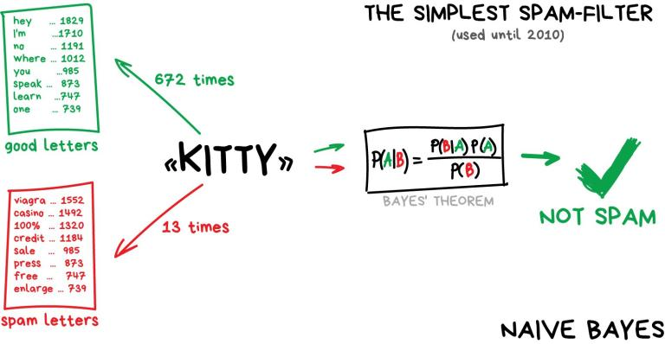
Idea of Naive Bayes classifier:
Pass it by: adding lots of "good" words at the end of the email - Bayesian poisoning.

Slide 21
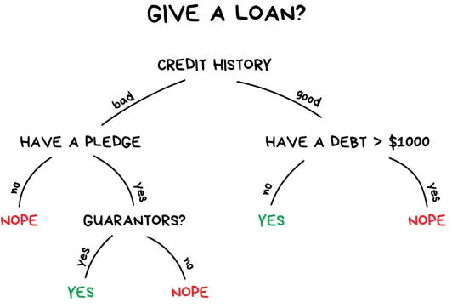
Idea of Decision Tree:
All the data automatically divided to yes/no questions. They could sound a bit weird from a human perspective, e.g., whether the creditor earns more than $128.12?

Slide 22
Idea of Decision Tree:
Bank has lots of profiles of people who took money before. They have data about age, education, occupation and salary and – most importantly – the fact of paying the money back. Or not.
When you google something, that's precisely the bunch of dumb trees which are looking for a range of answers for you. Search engines love them because they're fast.

Slide 23
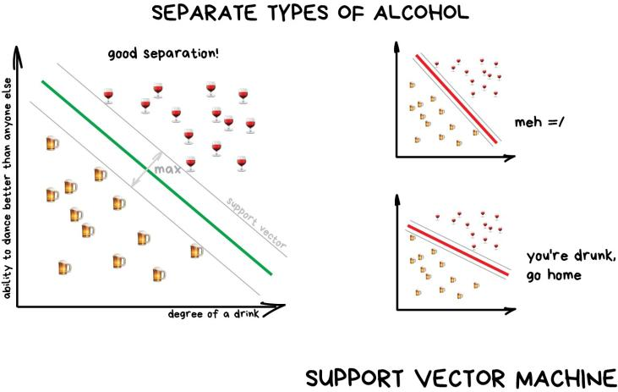
Idea of SVM:
The idea behind SVM is simple – it's trying to draw two lines between your data points with the largest margin between them. Look at the picture:

Slide 24
The rule of thumb is the more complex the data, the more complex the algorithm:
For text, numbers, and tables choose the classical approach. The models are smaller there, they learn faster and work more clearly.
For pictures, video and all other complicated big data things, definitely look at neural networks.

Slide 25
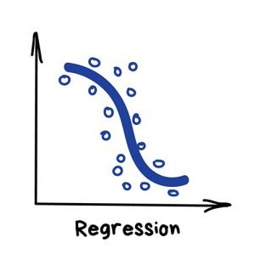
Regression: "Draw a line through these dots. Yep, that's the machine learning"
Today used for:
Demand and sales volume analysis
Price of house/car/rent
Traffic by time of the day
Any number-time correlations
Weather forecast

Slide 26
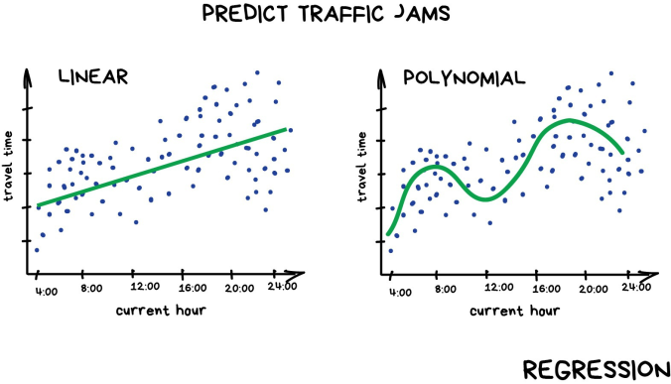
Regression is basically classification where we forecast a number instead of category.
And it's super smooth inside — the machine simply tries to draw a line that indicates average correlation

Slide 27
Unsupervised learning
Unsupervised was invented a bit later, in the ‘90s
It's usually useful for exploratory data analysis but not as the main algorithm
Specially trained meatbag with Oxford degree feeds the machine with a ton of garbage and watches it

Slide 28
Clustering - classification with no predefined classes
For market segmentation (types of customers, loyalty)
To analyze and label new data
Searching for similar photos
For image compression
Popular algorithms: K-means_clustering, Mean-Shift, DBSCAN

Slide 29
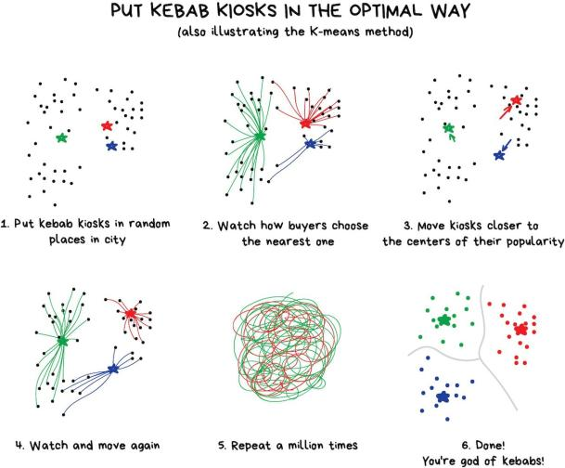
K-Means algotithm

Slide 30

DBSCAN
Interested in clustering? Check out this piece The 5 Clustering Algorithms Data Scientists Need to Know

Slide 31
Reinforcement Learning: "Throw a robot into a maze and let it find an exit”
Nowadays used for:
Games
Self-driving cars
Robot vacuums
Automating trading
Popular algorithms: Q-Learning, SARSA, DQN, A3C, Genetic algorithm

Slide 32
Reinforcement Learning:
Key idea: Surviving in an environment. Throw poor little robot into real life, punish it for errors and reward it for right deeds. Same way we teach kids
More effective way — сreate a virtual city based on a real map, populate with pedestrians and let the car learn to kill as few people as possible. When the robot is reasonably confident in this artificial GTA, it's freed to test in the real streets. Fun!

Slide 33
Examples:
https://www.youtube.com/watch?v=VMp6pq6_QjI (parking)
https://www.youtube.com/watch?v=gn4nRCC9TwQ (DeepMind)
https://youtu.be/L6bbFgjkqK0 (Flappy Bird)
https://www.youtube.com/watch?v=tlOIHko8ySg (boat)
https://en.wikipedia.org/wiki/AlphaGo (Go)
https://en.wikipedia.org/wiki/AlphaZero (Chess)

Slide 34
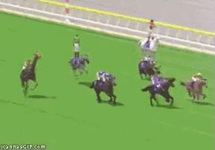
RL agents competition be like:

Slide 35
Ensemble Methods: "Bunch of stupid trees learning to correct errors of each other"
Nowadays used for:
Everything that fits classical algorithm approaches (but works better)
Popular algorithms: Random Forest, Gradient Boosting

Slide 36
Ensemble Methods
Ensembles and neural networks are two main fighters. Today they are producing the most accurate results and are widely used in production
Simple idea: If you take a bunch of inefficient algorithms and force them to correct each other's mistakes, the overall quality of a system will be higher than even the best individual algorithms.

Slide 37
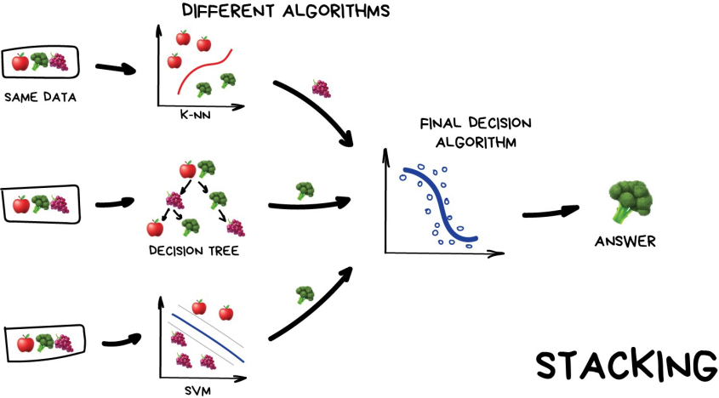
Stacking: you asking your friends for advice and then make your decision
Training session #1: What is Machine Learning?

Slide 38
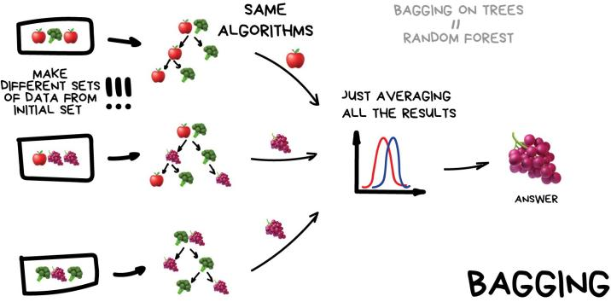
Bagging: Use the same algorithm but train it on different subsets of original data. In the end — just average answers.
Boxes around people's faces on your phone camera — it's probably the results of Random Forest work. Neural networks would be too slow to run real-time

Slide 39
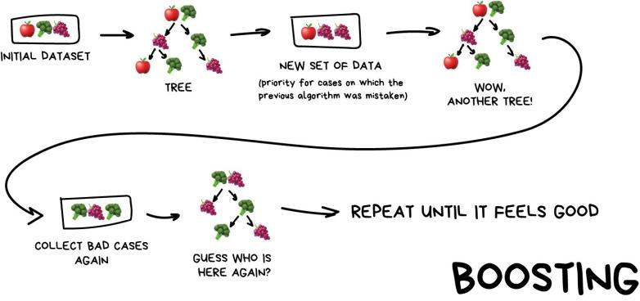
Boosting: Algorithms are trained one by one sequentially. Each subsequent one paying most of its attention to data points that were mispredicted by the previous one. Repeat until you are happy.

Slide 40
Boosting
The main advantage here — a very high, even illegal in some countries precision of classification that all cool kids can envy.
If you want a real example of boosting — open Facebook or Google and start typing in a search query. Can you hear an army of trees roaring and smashing together to sort results by relevancy? That's because they are using boosting.
CatBoost vs. LightGBM vs. XGBoost

Slide 41
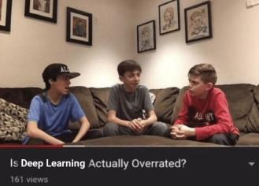
Neural Networks and Deep Leaning: "We have a thousand-layer network, dozens of video cards, but still no idea where to use it. Let's generate cat pics!"
Used today for:
Replacement of all algorithms above
Object identification on photos and videos
Speech recognition and synthesis
Image processing, style transfer
Machine translation

Slide 42
Neural Networks and Deep Leaning:
Once again:
The rule of thumb is the more complex the data, the more complex the algorithm:
For text, numbers, and tables choose the classical approach. The models are smaller there, they learn faster and work more clearly.
For pictures, video and all other complicated big data things, definitely look at neural networks.

Slide 43
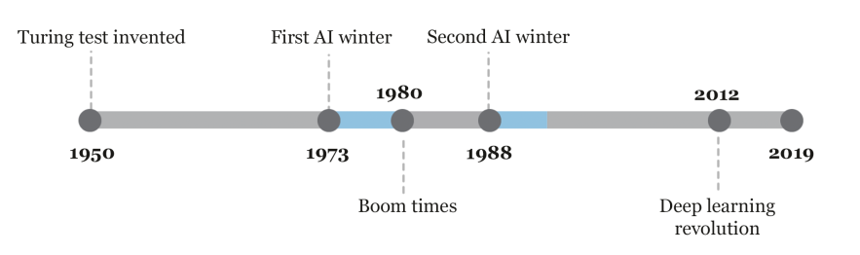
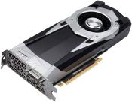
Neural Networks and Deep Leaning:
Unimaginable computation power at that time at 1990’s
Until 2012:
GPU entered the chat

Slide 44
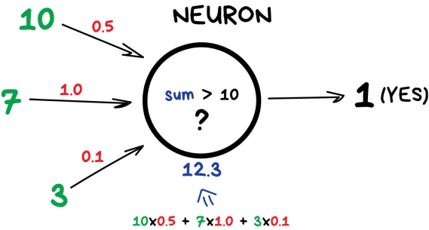
Neuron and Connections:
Neuron is a function with a bunch of inputs and one output. Its task is to take all numbers from its input, perform a function on them and send the result to the output.
Connections are like channels between neurons. They connect outputs of one neuron with the inputs of another so they can send digits to each other. Each connection has only one parameter — weight. It's like a connection strength for a signal. When the number 10 passes through a connection with a weight 0.5 it turns into 5.

Slide 45
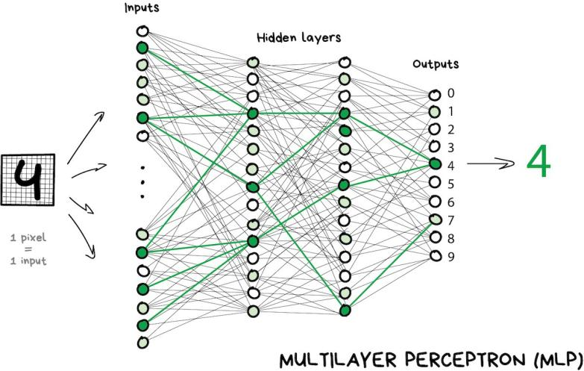
Layers:

Slide 46
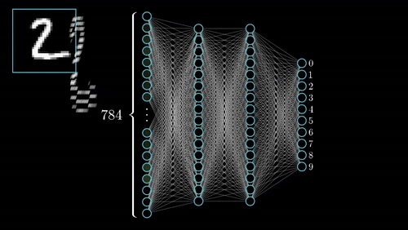

Slide 47
Weights:
How we will assign weights to connections? We have training dataset: samples of 'inputs' and proper 'outputs’!
All weights are assigned randomly
After we show it a digit it emits a random answer because the weights are not correct yet, and we compare how much this result differs from the right one
Then we start traversing network backward from outputs to inputs and tell every neuron 'hey, you did activate here but you did a terrible job and everything went south from here downwards, let's keep less attention to this connection and more of that one, mkay?’
After hundreds of thousands of such cycles of 'infer-check-punish', there is a hope that the weights are corrected and act as intended.

Slide 48
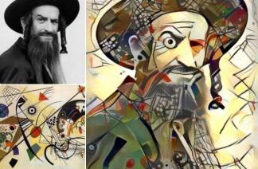
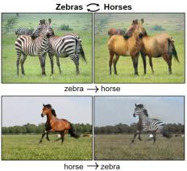
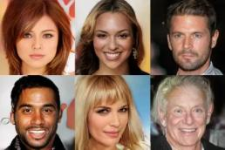
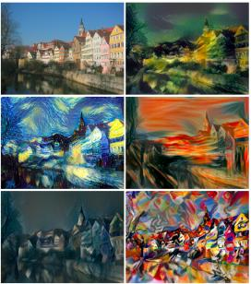
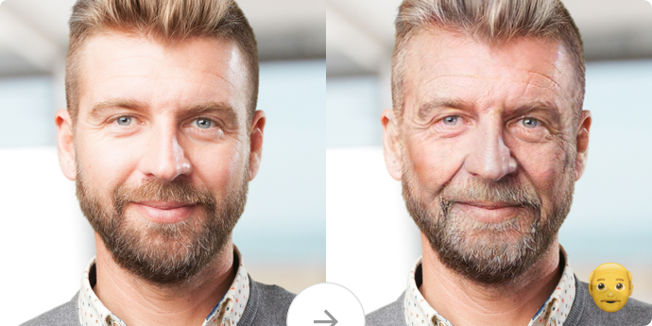
Examples of GAN:
Google quick draw: https://quickdraw.withgoogle.com/?locale=en_US#
Google faces: https://teachablemachine.withgoogle.com
https://youtu.be/p1b5aiTrGzY?t=257 (Samsung live portraits)

Slide 49
Questions!

Slide 50
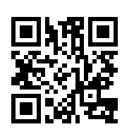
Anonymous feedback:
Link: https://forms.gle/83hW3NYzxD2LzpuF7
Or QR code:

